Slide 1


TEXT SUMMARIZATION BY JEMIMA PAULRAJ DELAXSHANA SANTHIRAVATHANAN GEEDHU KV

Slide 2

TEXT SUMMARIZATION
Text summarization is the process of generating A concise summary of the voluminous text. It focuses on the most important or relevant information within the original content, without losing the overall meaning

Slide 3
KEY DRIVERS OF TEXT SUMMARIZATION TECHNOLOGY
Large language models (LLMs) have massively democratized summarization, resulting in higher demand from end users, who want to apply the technology to a broad spectrum of use cases.
Text summarization reduces the employee time and effort needed to acquire insight from content, leading to faster decision making.
Approaches to AI herald abstraction, including transformers, have advanced. The abstraction approach has become a viable way to apply text summarization at the domain, foundation and situation levels of the application portfolio.

Slide 4
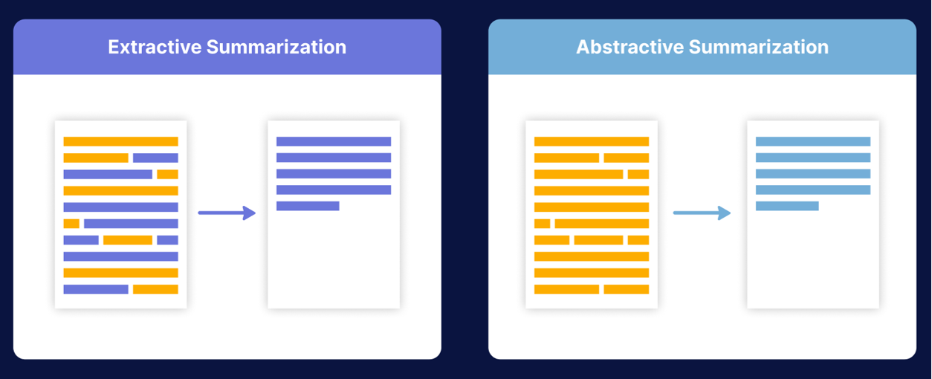
TYPES OF TEXT SUMMARIZATION
Extractive summarization means identifying important sections (paragraphs or sentences or even words) of the text and selecting (copy paste) them producing a subset of the text from the original text.
Abstractive summarization is the technique of generating a summary of a text from its main ideas, not by copying verbatim most salient sentences from the text.

Slide 5
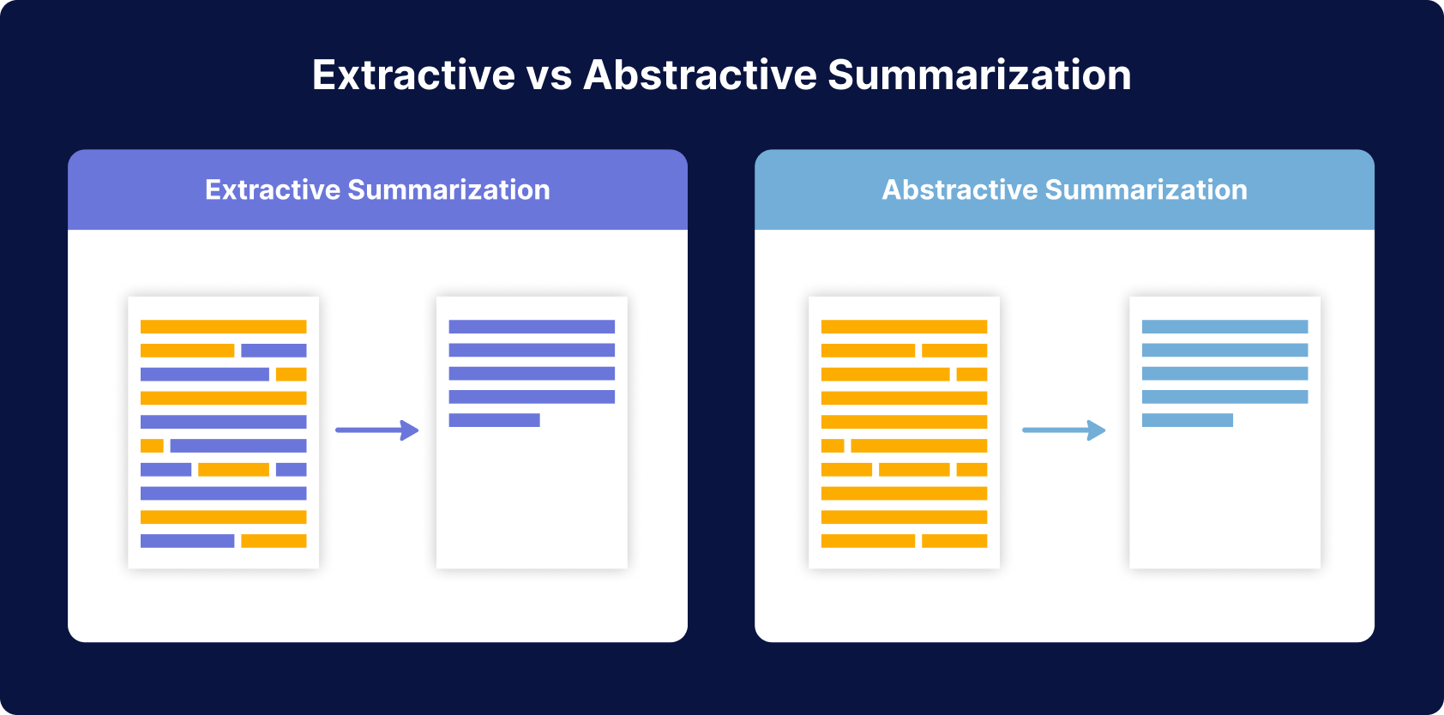

Slide 6
Comparison between abstract and extract
ASPECT | ABSTRACT TEXT SUMMARIZATION | EXTRACT TEXT SUMMARIZATION
Process | Paraphrases and rephrases content to capture main ideas. | Selects and extracts specific sentences directly from the text.
Creativity | Involves creative language generation and paraphrasing. | Maintains exact wording, less emphasis on creative expression.
Use Cases | News article summarization, creative writing tasks. | Legal documents, scientific papers, tasks requiring precision.
Domain Independence | More domain-independent, focuses on underlying concepts. | Relies on the source text, potentially more domain-specific.
Training Data Challenges | May require larger and more diverse training datasets. | May be less demanding in terms of training data complexity.
Preservation of Author's Voice | Tends to introduce the system's voice and style. | Preserves the original author's voice and writing style.

Slide 7
Main techniques to perform extractive summarization
Text Ranking : Assigns scores to sentences or phrases based on their relevance and importance, and selects the sentences with the highest scores to form the summary.
Clustering : Groups similar sentences together and selects one representative sentence from each group for the summary.
Feature-based methods : Extracts features from the text, such as word frequency, positional information, and named entity recognition, and uses these features to rank or select sentences for summarization.

Slide 8
Main techniques to perform abstractive summarization
Sequence-to-sequence Models : A type of neural network architecture that is trained to generate a new text from an input text, by encoding the input text into a fixed-length vector, and then decoding the vector into the output text.
Pointer-Generator Networks : A type of sequence-to-sequence model that balances the tradeoff between extractive and abstractive summarization by allowing the model to both generate new words and copy words from the input text (copy mechanism).

Slide 9
Text summarization in practice
Preprocessing : Clean the text by removing stop words, punctuations, and converting the text to lowercase.
Text Representation : Convert the text into a numerical format, such as bag-of-words or word embeddings, so that it can be processed by machine learning algorithms.
Model Training : Train a machine learning model on a large corpus of text data to learn patterns and relationships between words. Supervised learning is the most efficient way because you provide examples of summaries from which the model can learn.
Summarization : Use the trained model to generate a summary of the input text.
Evaluation : Use a metric such as ROUGE (Recall-Oriented Understudy for Gisting Evaluation).

Slide 10

ALGORITHMS

Slide 11
Source Text
Peter and Elizabeth took a taxi to attend the night party in the city, while at the party, Elizabeth collapsed and was rushed to the hospital
Summary
Peter and Elizabeth attend party city, Elizabeth rushed hospital.
Source Text
Peter and Elizabeth took a taxi to attend the night party in the city, while at the party, Elizabeth collapsed and was rushed to the hospital
Summary
Elizabeth was hospitalized after attending a party with peter.

Slide 12
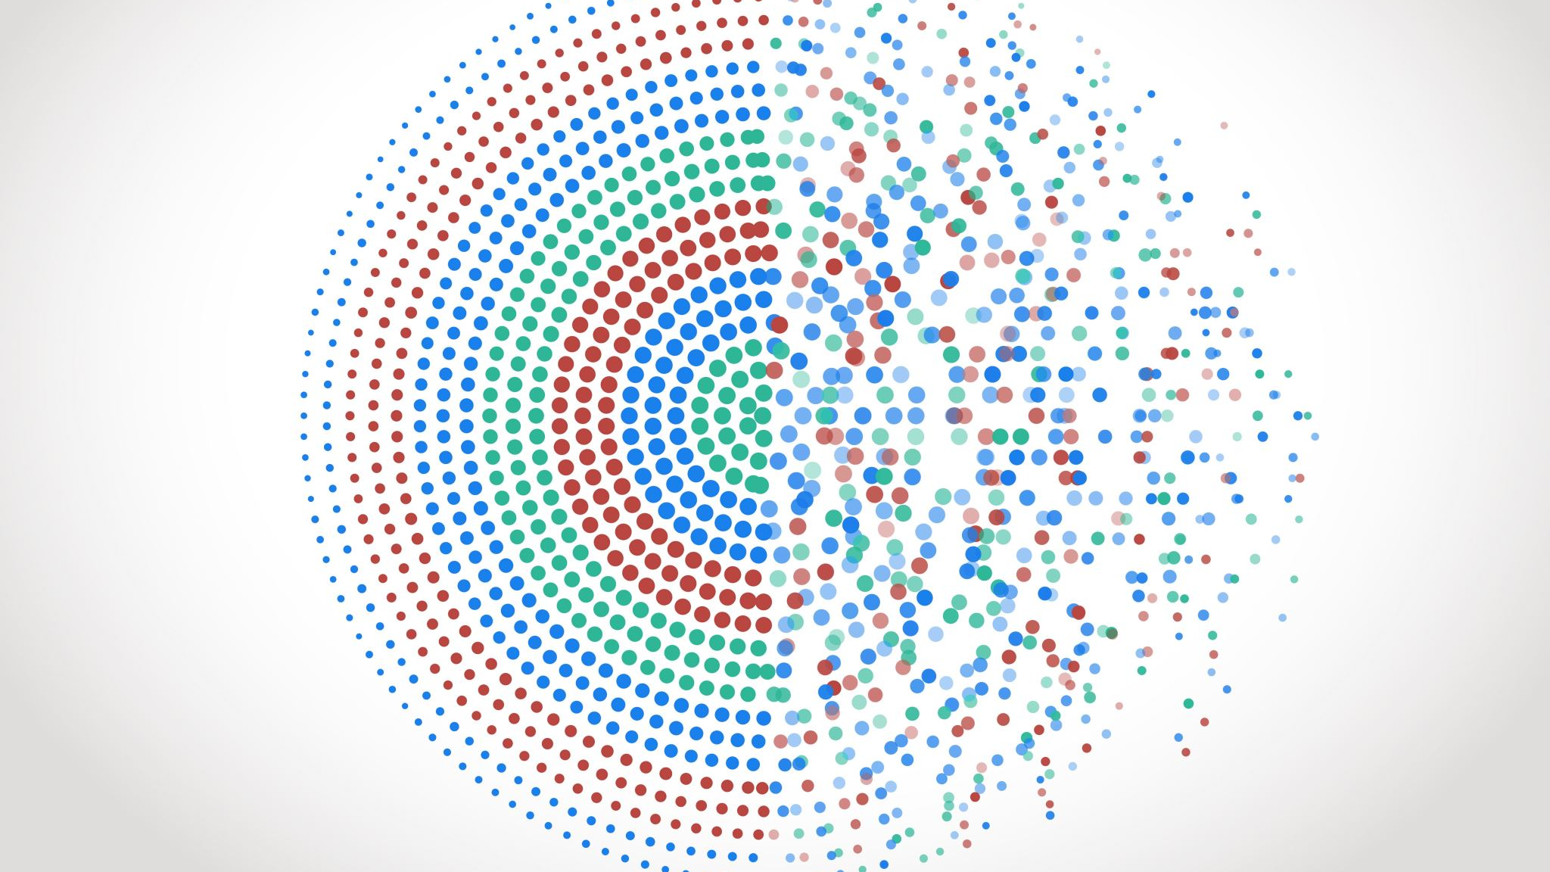






Approaching Extractive Summarization
Input Text
Pre-processing
Convert to vectors
Sentence Scoring
Sentence Reorganizer
Summary

Slide 13
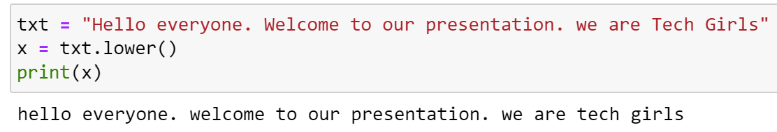
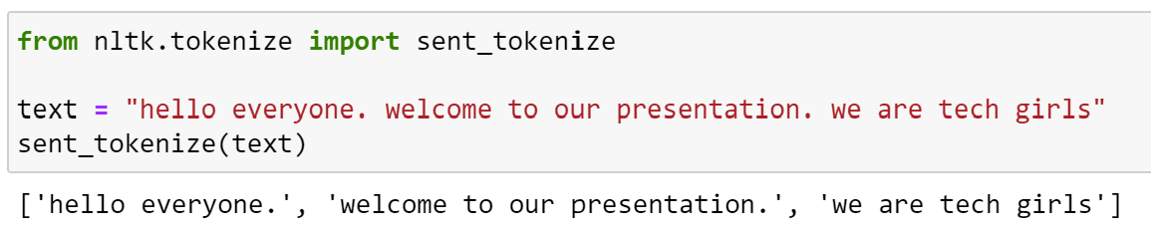
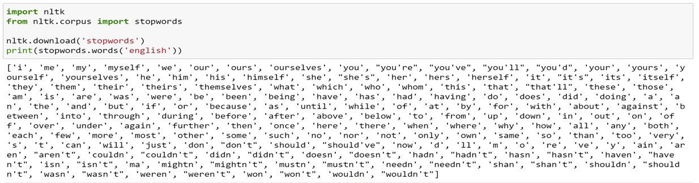
PRE-PROCESSING
Tokenize the text
Input the text to lowercase
Remove stop words
Stemming and Lemmatization
Stemming: Process of reducing an infected word to their word stem
Eg: Change, Changing, Changes → Chang (takes stem word)
Lemmatization: It is similar to stemming but will give a meaningful word.
Eg: Change, Changing, Changes → Change (meaningful)

Slide 14
Converting to vectors
Count-based techniques like CountVectorizer, Tf-Idf Vectorizer
01
Pretrained word embeddings based techniques like Word2Vec
02
Pretrained SOTA transformers like BERT
03

Slide 15
COUNT VECTORIZER – Bag of words
Sent 1 → He is a good boy
Sent 2 → she is a good girl
Sent 3 → Boy and Girl are good
Text → lower the sentence → remove stop words → do stemming or lemmatization
Sent1 → good boy
Sent2 → good girl
Sent3 → boy girl good
Words | Frequency
good | 3
boy | 2
girl | 2
 | good | boy | girl
Sen1 | 1 | 1 | 0
Sen2 | 1 | 0 | 1
Sen3 | 1 | 1 | 1

Slide 16
TF-IDF (Term frequency – inverse document frequency
1. Words Frequency
2. Find TF and IDF
Words | Frequency
good | 3
boy | 2
girl | 2
TF = No of repetition of words in sentence / No of words in the sentence
IDF = Log ( no of sentences / no of sentences containing that word )
TF
IDF
TF * IDF
 | Sent1 | Sent2 | Sent3
good | 1/2 | 1/2 | 1/3
boy | 1/2 | 0 | 1/3
girl | 0 | 1/2 | 1/3
words | IDF
good | Log(3/3)
boy | Log(3/2)
girl | Log(3/2)
 | good | boy | girl
sent1 | 0 | ½ * log (3/2) | 0
sent2 | 0 | 0 | ½ * log (3/2)
sent3 | 0 | ½ * log(3/2) | 1/3 *log(3/2)

Slide 17
WORD2VEC
In Both BOW and TF-IDF approaches semantic information is not stored.
In this method the words are represented as vectors of 32 or more dimensions instead of single numbers.
CBOW (Continuous Bag of Words)
Find target word based on context word
Eg: I ___ Natural language processing.
SKIP GRAM
Find Context word based on target word
Eg : ______ language______.

Slide 18
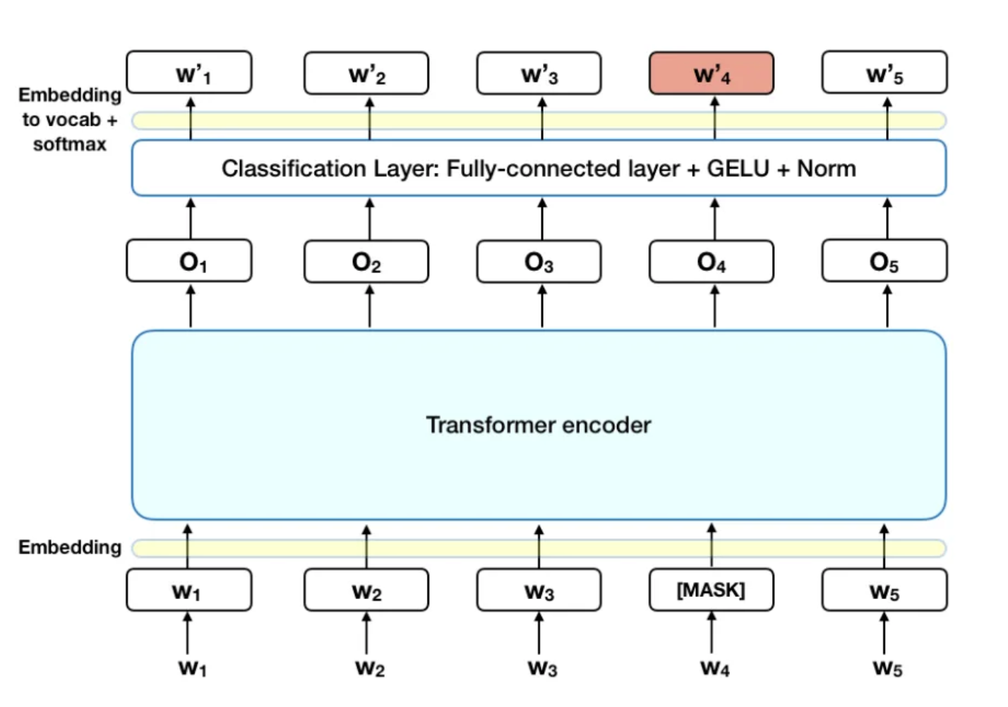
BERT

Slide 19
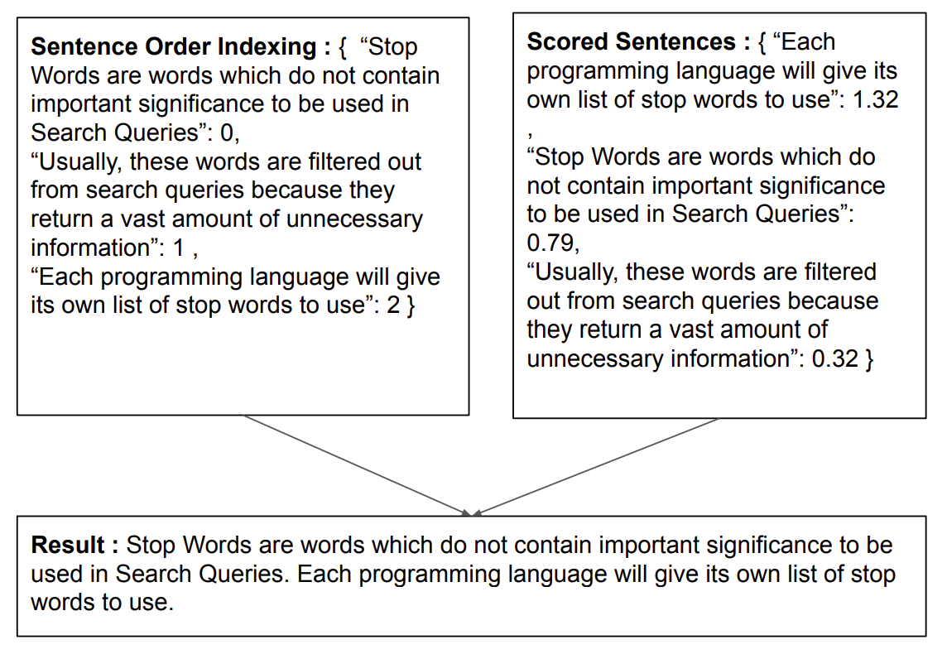
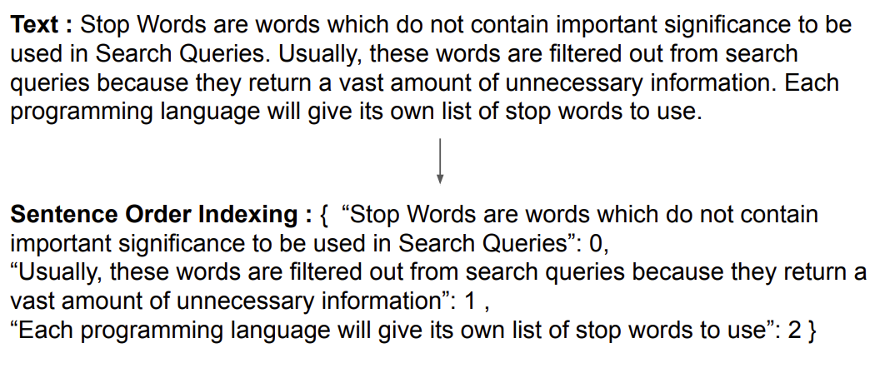
Sentence Scoring AND SENTENCE REORGANIZATION

Slide 20

USE CASES

Slide 21
USE CASES
Social media/ email summarization
Medical record summarization
SEO and Search Marketing
E-learning and Education
Customer feedback and review

Slide 22
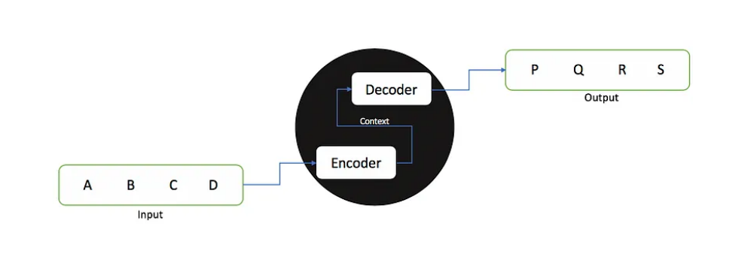
Social media / email summarization
Text summarizing can be used to highlight important points, condense information.
For abstractive social media text summary, we can apply the selected reinforced Seq2Seq attentive model. It can more effectively filter out irrelevant data from the encoder module and use the reinforcement learning policy to produce better outcomes.
Advantages :
Improved user engagement (trends)
Tracking the brands and sentiment analysis
Personalized content delivery

Slide 23
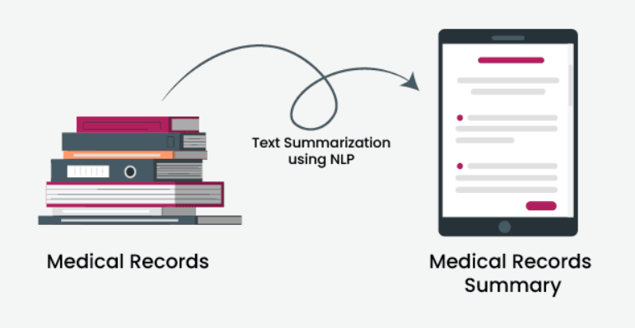
Medical record summarization
There are two methods for summarizing medical records: Transformer-based summarization (Traditional) and frequency-based sentence scoring(Modern)
Advantages
Improved decision making
Efficient data retrieval
Research and analytics
Enhanced Coordination of Patient Care
Note : However, for implementation to be successful, privacy, data types, and integration with current systems must all be carefully considered.

Slide 24
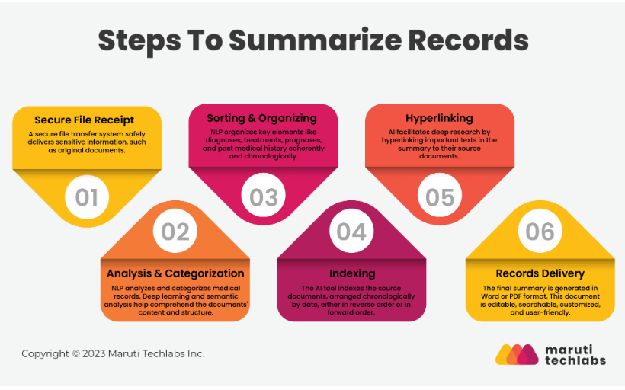
Problems
Handling biomedical data
Identifying key points
Maintaining accuracy

Slide 25
Customer feedback and review
Collect short reviews and preprocessing
Topic modeling
Topic prediction
Topic understanding & sentiment analysis
Summary generation
Advantages:
Get customer review over the products.
Generate evaluation metrics (Ex: ROUGE)
Find special features

Slide 26
PROS and cons
PROS :
Quick and efficient
Retrieval of information
Multi-language summarization
Automatic activity
CONS:
Loss of meaning
Sensitivity
Biased information
Named Entity and Resolution of Coreferences
Limitations

Slide 27
CHALLENGES
Although the technology continues to improve in performance, it falls short of human-derived summarization for the following reasons:
Quality: The extraction approach is well-established but produces summaries that are further removed from the quality of human-generated summaries.
Contextualization: The abstraction approach has emerged in recent years and produces summaries that are closer to human-generated summaries. However, it requires training in context and is therefore more challenging and costly to apply.
Omission of key information: Missing vital information from a summary reduces the quality of insight needed from the source document, adversely impacting analysis, decision, and action. Such risks are intolerable in many vertical industries and functional domains, such as compliance within banking or research within life sciences and healthcare.

Slide 28
CHALLENGES
Omission of key information: Missing vital information from a summary reduces the quality of insight needed from the source document, adversely impacting analysis, decision and action. Such risks are intolerable in many vertical industries and functional domains, such as compliance within banking or research within life sciences and healthcare.
Hallucination and errors: Content produced by text summarization techniques that leverage LLMs should not be considered entirely reliable and error-free. There are concerns around the trust and explainability of the models as well.

Slide 29

DEMO

Slide 30
REFERENCES
(2023, July 27). Hype Cycle for Natural Language Technologies, 2023. Gartner. https://www.gartner.com/interactive/hc/4577099?ref=solrctp&refval=384822569&ipDocCd=792992
(2023, November 14). Text Summarization Using NLP: Techniques and Use Cases. Addepto. https://addepto.com/blog/text-summarization-using-nlp-techniques-and-use-cases/
(2023, November 9). Text Summarization for NLP: 5 Best APIs, AI Models, and AI Summarizers in 2024. AssemblyAI. https://www.assemblyai.com/blog/text-summarization-nlp-5-best-apis/
(2023, November 7). Unlocking the power of NLP in Healthcare. https://marutitech.com/nlp-in-healthcare.
A. Keller, J. Furst, D. Raicu, P. Hastings and R. Tchoua, "Text Summarization towards Scientific Information Extraction," 2022 IEEE 18th International Conference on e-Science (e-Science), Salt Lake City, UT, USA, 2022, pp. 225-235
J. N. Madhuri and R. Ganesh Kumar, "Extractive Text Summarization Using Sentence Ranking," 2019 International Conference on Data Science and Communication (IconDSC), Bangalore, India, 2019, pp. 1-3

Slide 31

Thank You

